Slide 1


GIGABYTE Confidential: Internal Use Only

Slide 2






Here Comes 7 Series !
GIGABYTE Confidential: Internal Use Only

Slide 3






GIGABYTE Confidential: Internal Use Only

Slide 4
GIGABYTE Confidential: Internal Use Only

Slide 5

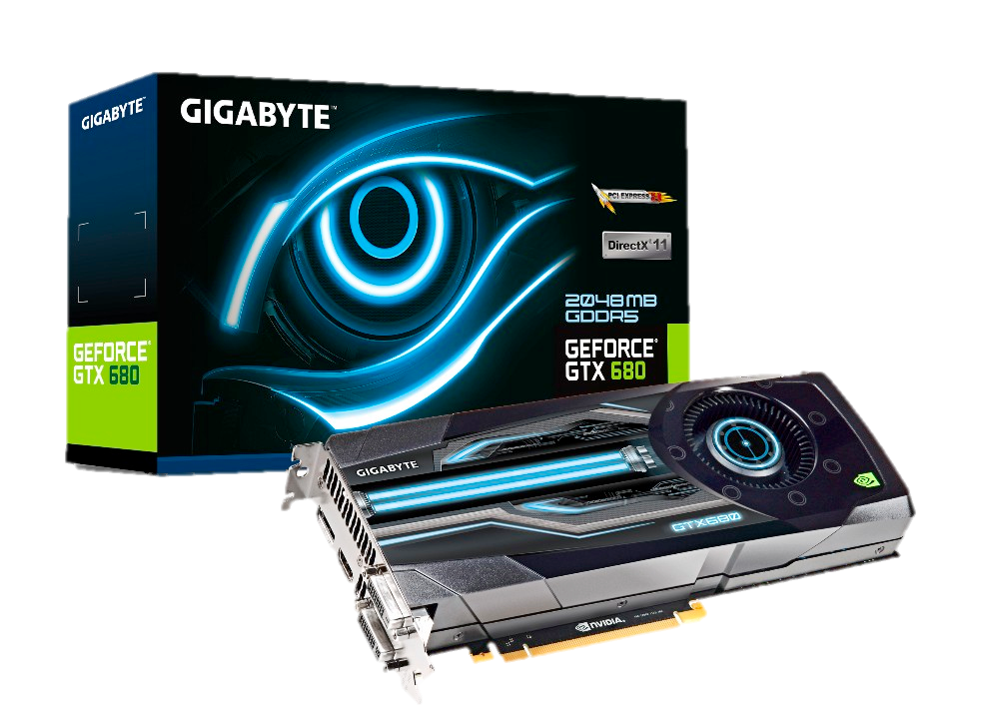
GIGABYTE Confidential: Internal Use Only
Support for PCI Express Gen.3
Unleash your VGA card’s performance!
GIGABYTE GV-R795WF3-3GD
8Gb/s
Data bandwidth
4Gb/s
PCI Express Gen. 2 = 5.0GT/s = 4Gb/s
PCI Express Gen. 3 = 8.0GT/s = ~ 8Gb/s
PCI e Gen 2
PCI e Gen 3
Chipset | GeForce GTX 680
Memory Size | 2048 MB
Card Bus | PCI-E 3.0
The PCI-E Gen.3 technology delivers maximum data bandwidth for the latest VGA cards (NVIDIA GTX 600 series, AMD HD 7000 series).

Slide 6
GIGABYTE Confidential: Internal Use Only

Slide 7



GIGABYTE Confidential: Internal Use Only
Default support DDR3 1600 Memory
Get prepared for overclocking your memory!
3000+ MHz
G.Skill RipjawsZ DDR3-1600
Memory OC ability
2000MHz
DDR3 1333 OC→DDR3 2000
DDR3 1600 OC→DDR3 2400
1600MHz
1333MHz
DDR3 1333
DDR3 1600
Starting from 1600MHz, the latest 7 series motherboards provide an incredible over clocking ability on your DDR3 memory.

Slide 8
GIGABYTE Confidential: Internal Use Only

Slide 9


GIGABYTE Confidential: Internal Use Only
Provide native USB3.0 ports
Experience ultra fast data transfer!
5Gbps
WD My Passport USB3.0 1TB
Tranfer Speed
USB2.0 = 480Mbps = ~48MB/s
USB3.0 = 5Gbps = ~500MB/s
480Mbps
USB2.0
USB3.0
(Start bit + 8 bit + Stop bit = ~1 Byte)
Transfer your large media files at blazing fast speeds with USB 3.0.

Slide 10

GIGABYTE Confidential: Internal Use Only

Slide 11
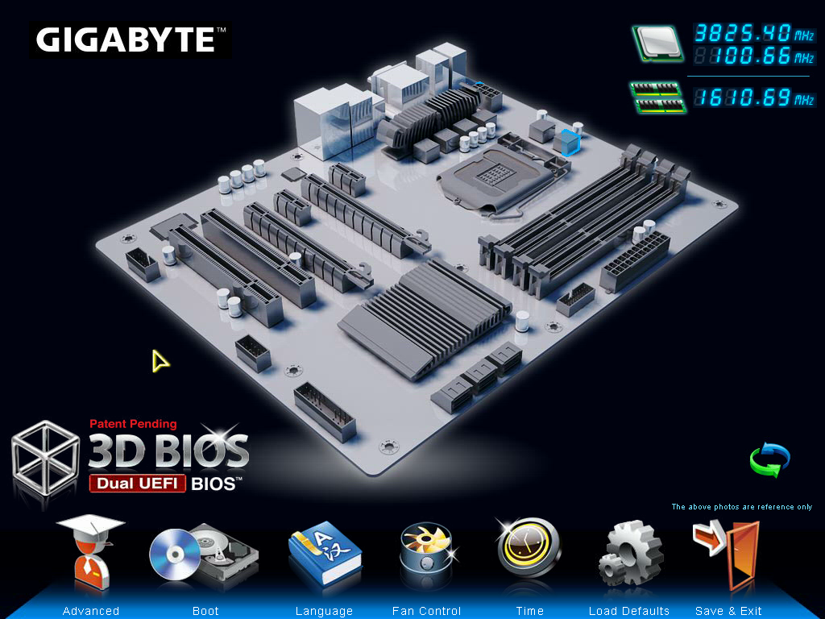

GIGABYTE Confidential: Internal Use Only
UEFI BIOS : 3D Mode

Slide 12
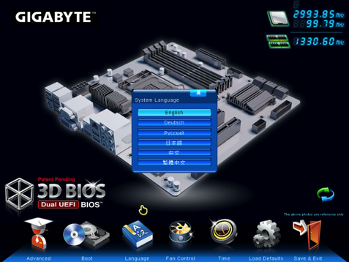
GIGABYTE Confidential: Internal Use Only
UEFI BIOS : Multi Language

Slide 13
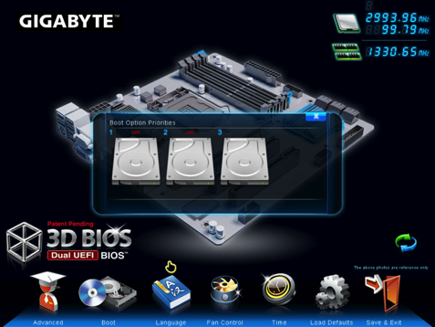
GIGABYTE Confidential: Internal Use Only
UEFI BIOS : Select Boot Device

Slide 14
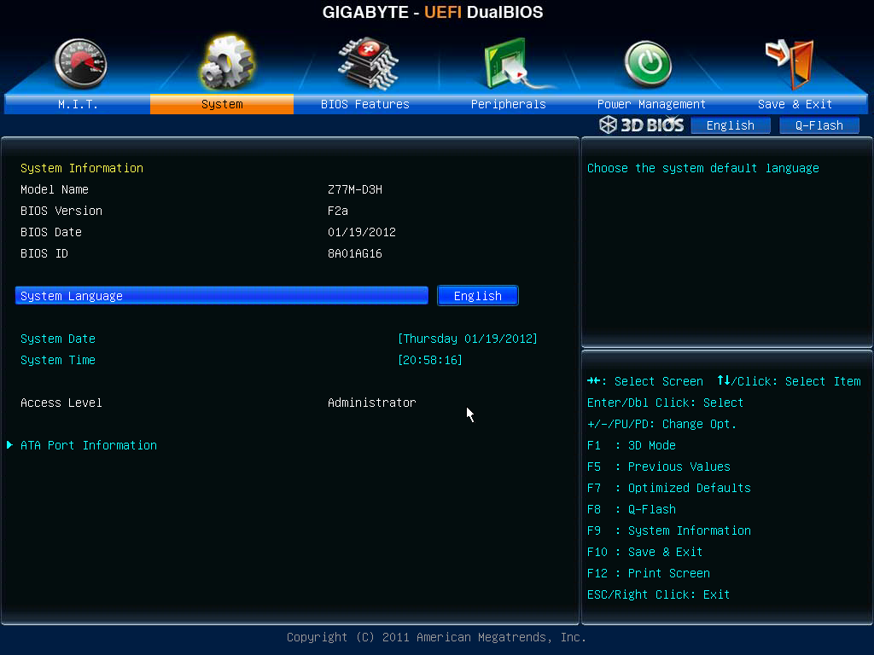
GIGABYTE Confidential: Internal Use Only
UEFI BIOS : Advanced Mode

Slide 15



GIGABYTE Confidential: Internal Use Only

Slide 16

GIGABYTE Confidential: Internal Use Only

Slide 17
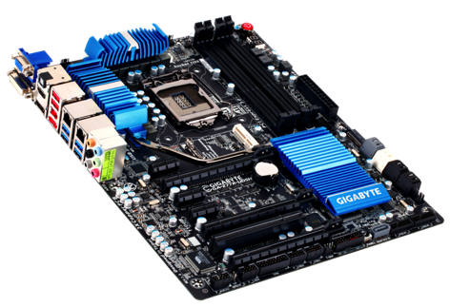


GIGABYTE Confidential: Internal Use Only

Slide 18
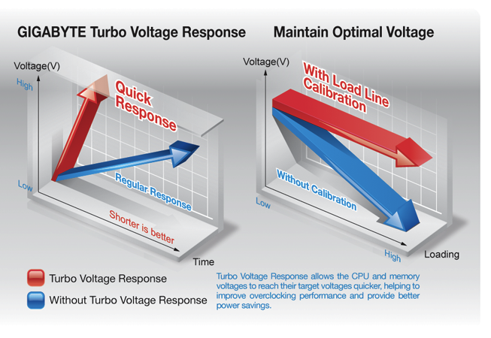
GIGABYTE Confidential: Internal Use Only

Slide 19

GIGABYTE Confidential: Internal Use Only
3D Power Utility

Slide 20


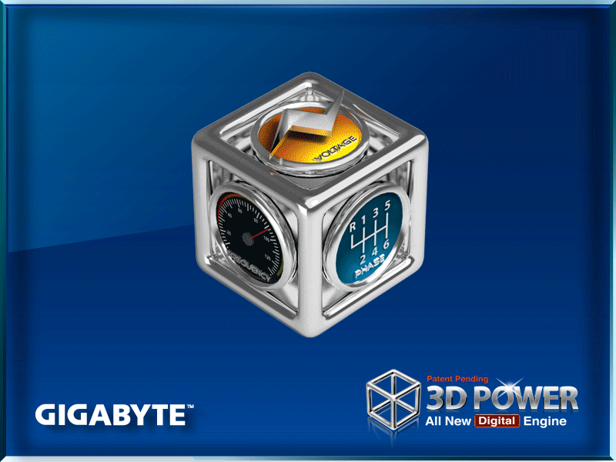

GIGABYTE Confidential: Internal Use Only
3D Power Utility
3D Power utility adjustment setting may vary by model

Slide 21

GIGABYTE Confidential: Internal Use Only

Slide 22
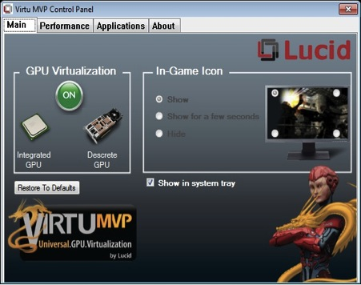

GIGABYTE Confidential: Internal Use Only
Increases gaming FPS 30-70%
Improves Vsync frame rates – up to 120 FPS
Sharpens visual quality without tearing
Notes:
Virtu Universal MVP is an optimized Lucid Virtu GPU virtualization software that makes your PC look better, respond faster, process video and media smoother, all within a low power environment.

Slide 23




GIGABYTE Confidential: Internal Use Only
Lucid HyPerformance
HyPerformance combines iGPU with Discrete GPU for performance boost.
CPU
GPU
Engine
Engine
Up to 50% FPS GAIN !
GPU

Slide 24
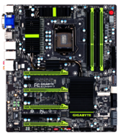
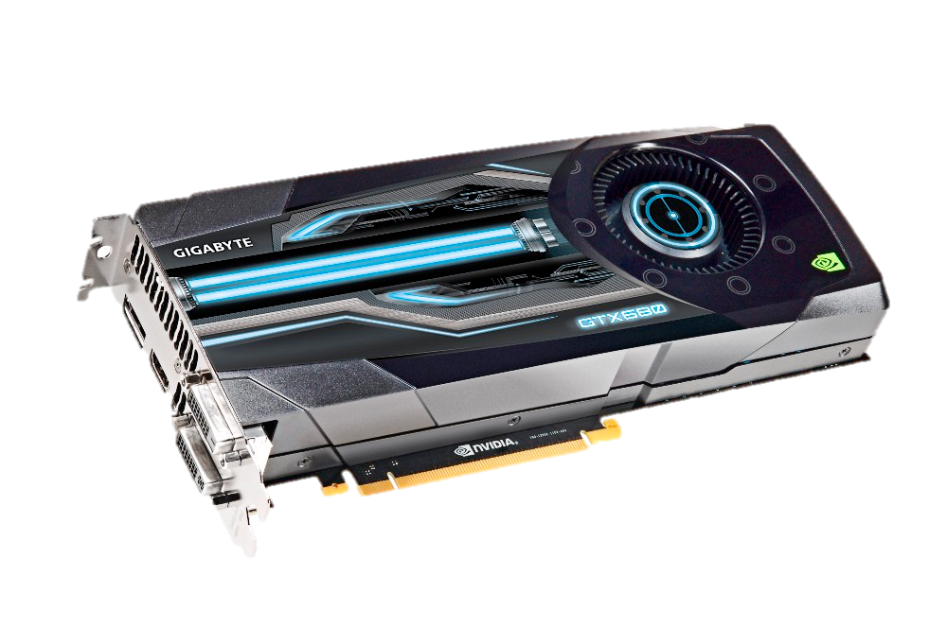



GIGABYTE Confidential: Internal Use Only
Lucid HyPerformance
Platform Requirement
GIGABYTE Z77 motherboard
Intel HD
Graphics
Discrete VGA Card
50% Performance BOOST !
Virtu MVP Software

Slide 25

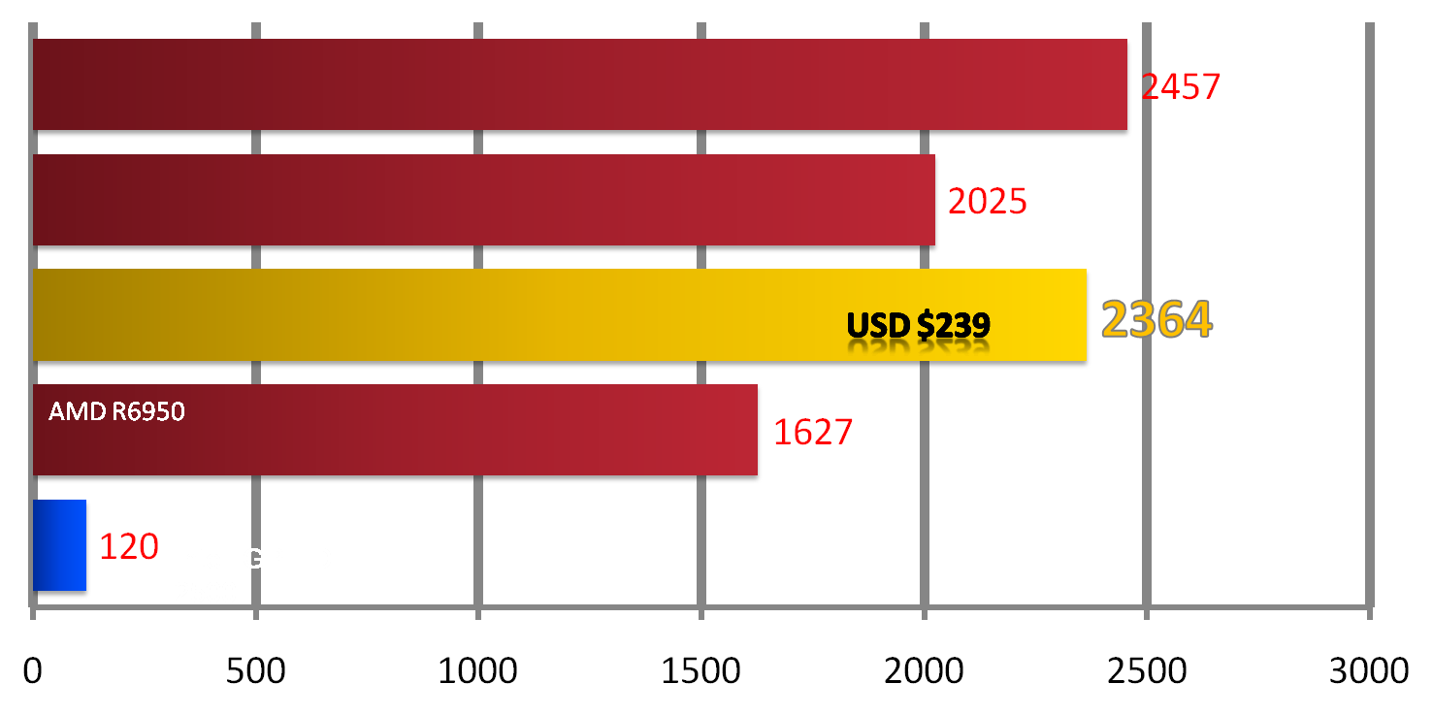
GIGABYTE Confidential: Internal Use Only
Free Upgrade for your Graphics
Performance between 7970~7950
AMD R7970
USD $599
AMD R7950
USD $499
GIGABYTE Z77 + MVP + R6950
USD $239
3D Mark 11 Extreme

Slide 26



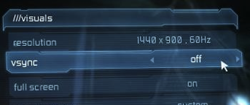
GIGABYTE Confidential: Internal Use Only
Lucid Virtual VSync
Playing 3D Games above 60 FPS often results in image “tearing”
Old solution:
Enable on-game V-Sync setting
Problem: This Limits all frame rate @ 60FPS, also reduce KB+ Mice response time => LAGS

Slide 27

GIGABYTE Confidential: Internal Use Only
Lucid Virtual VSync
New solution: Lucid Virtual VSync
Lucid’s technology maintains high FPS without tearing effect. Also provides high input device response speed.
Lucid Virtual Vsync Delivers:
Enhanced performance - when system has dGPU and iGPU
Unlimited frame rates - beyond traditional in-game VSync
Flawless visual quality without tearing
Up to 250% better responsiveness vs. standard VSync

Slide 28
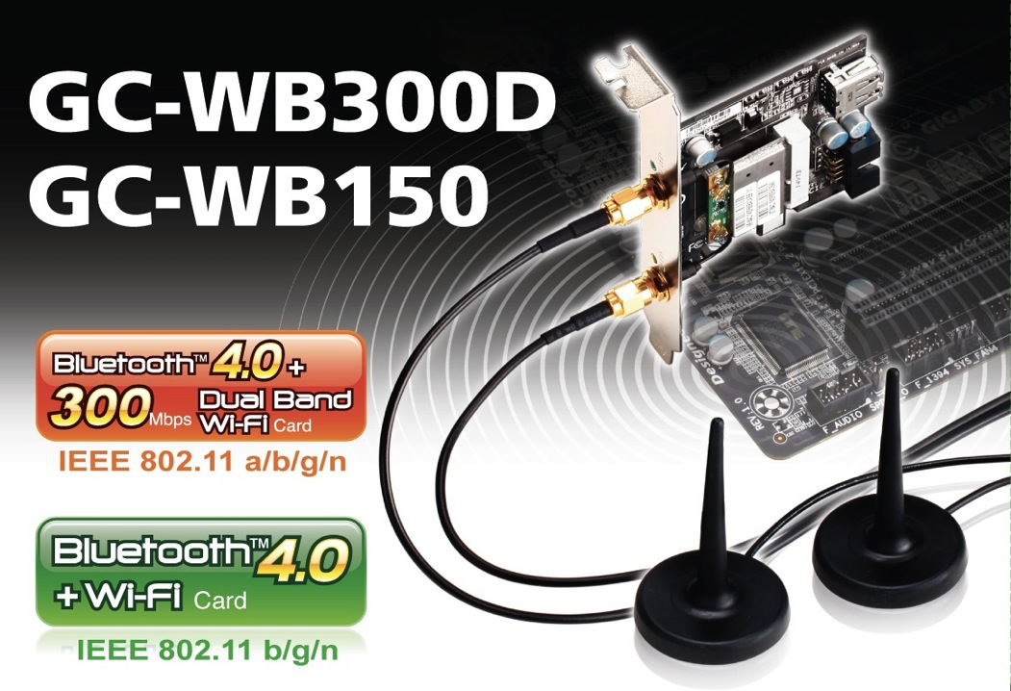
GIGABYTE Confidential: Internal Use Only

Slide 29
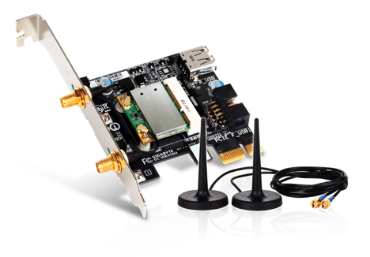
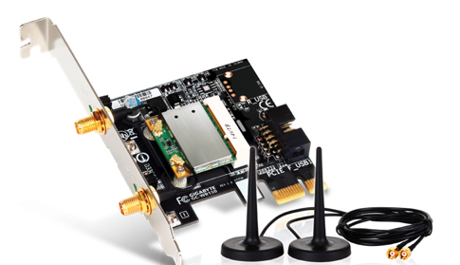


GIGABYTE Confidential: Internal Use Only
GC-WB300D
GC-WB150
Bluetooth 4.0 + 802.11n

Slide 30

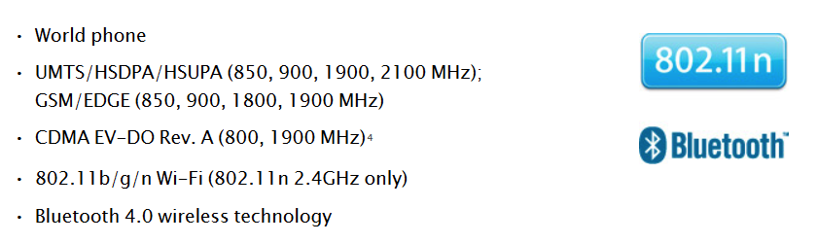

GIGABYTE Confidential: Internal Use Only
Source: Apple website
http://www.apple.com/iphone/specs.html

Slide 31
GIGABYTE Confidential: Internal Use Only
7 series Product Pictures and Retail Boxes

Slide 32

GIGABYTE Confidential: Internal Use Only
G1.Sniper 3

Slide 33

GIGABYTE Confidential: Internal Use Only
Z77X-UD5H WiFi

Slide 34

GIGABYTE Confidential: Internal Use Only
Z77X-UD3H

Slide 35

GIGABYTE Confidential: Internal Use Only
Z77X-D3H

Slide 36

Z77-D3H

Slide 37

P75-D3

Slide 38

B75M-D3V

Slide 39
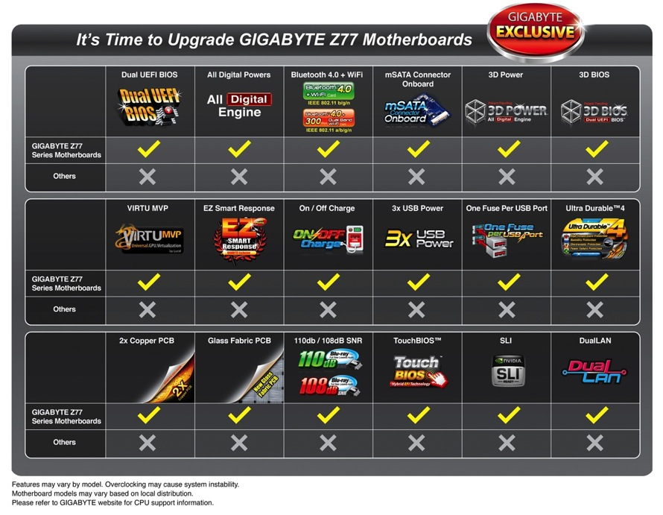
GIGABYTE Confidential: Internal Use Only

Slide 40
GIGABYTE Confidential: Internal Use Only
Thank you

