Slide 1


GIGABYTE Confidential: Internal Use Only

Slide 2






Here Comes 7 Series !
GIGABYTE Confidential: Internal Use Only

Slide 3






GIGABYTE Confidential: Internal Use Only

Slide 4
GIGABYTE Confidential: Internal Use Only

Slide 5

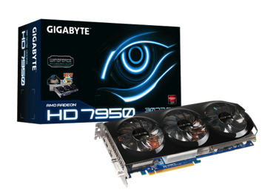
GIGABYTE Confidential: Internal Use Only
Support for PCI Express Gen.3
Unleash your VGA card’s performance !
GIGABYTE GV-R795WF3-3GD
8Gb/s
Data bandwidth
4Gb/s
PCI Express Gen. 2 = 5.0GT/s = 4Gb/s
PCI Express Gen. 3 = 8.0GT/s = ~ 8Gb/s
PCI e Gen 2
PCI e Gen 3
Chipset | Radeon HD 7950
Memory Size | 3072 MB
Card Bus | PCI-E 3.0
The PCI-E Gen.3 technology delivers maximum data bandwidth for the latest VGA cards (AMD HD 7000 series, NVidia GTX 600 series).

Slide 6
GIGABYTE Confidential: Internal Use Only

Slide 7

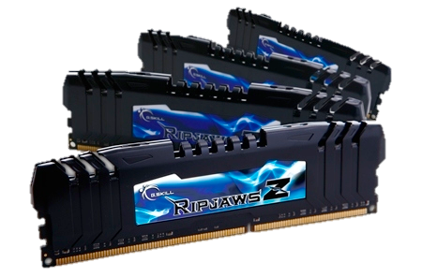

GIGABYTE Confidential: Internal Use Only
Default support DDR3 1600 Memory
Get prepared for overclocking your memory !
2400MHz
G.Skill RipjawsZ DDR3-1600
2000MHz
Memory OC ability
DDR3 1333 OC→DDR3 2000
DDR3 1600 OC→DDR3 2400
1600MHz
1333MHz
DDR3 1333
DDR3 1600
Starting from 1600MHz, the latest 7 series motherboards provide an incredible over clocking ability on your DDR3 memory.

Slide 8
GIGABYTE Confidential: Internal Use Only

Slide 9
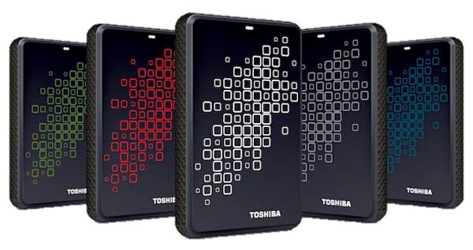

GIGABYTE Confidential: Internal Use Only
Provide native USB3.0 ports
Experience ultra fast data transfer !
5Gbps
Toshiba Canvio V5 USB3.0 1TB
Tranfer Speed
USB2.0 = 480Mbps = ~48MB/s
USB3.0 = 5Gbps = ~500MB/s
480Mbps
USB2.0
USB3.0
(Start bit + 8 bit + Stop bit = ~1 Byte)
Transfer your large media files at blazing fast speeds with USB 3.0.

Slide 10

GIGABYTE Confidential: Internal Use Only

Slide 11
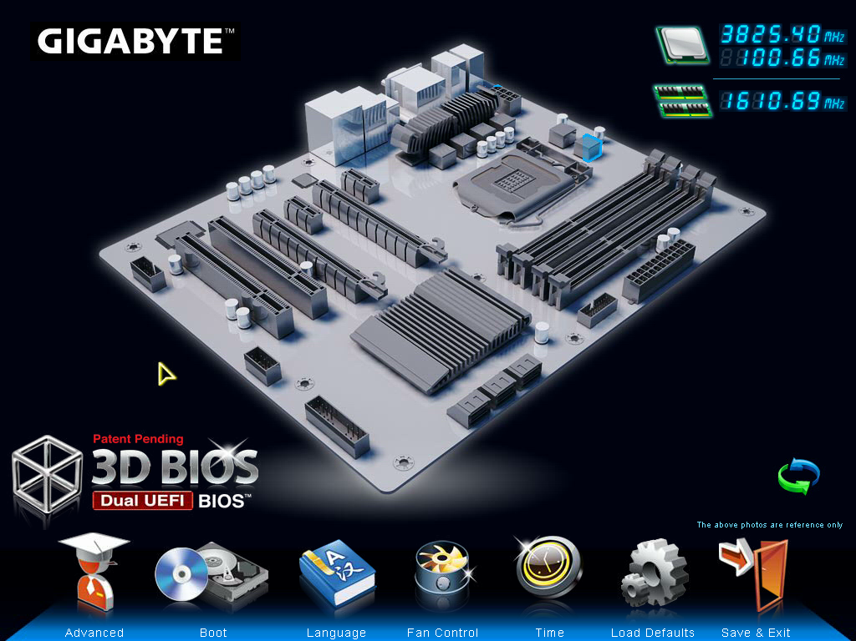

GIGABYTE Confidential: Internal Use Only
UEFI BIOS : 3D Mode

Slide 12
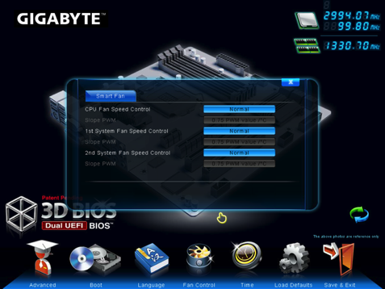
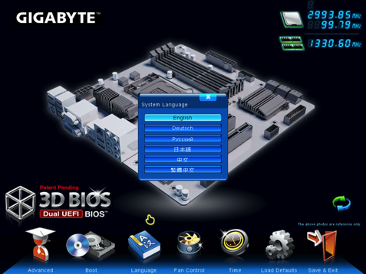
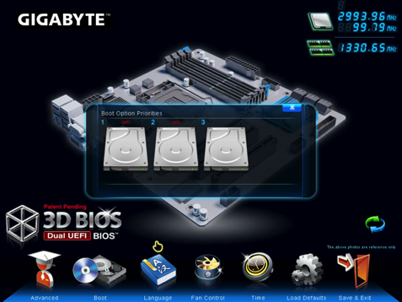
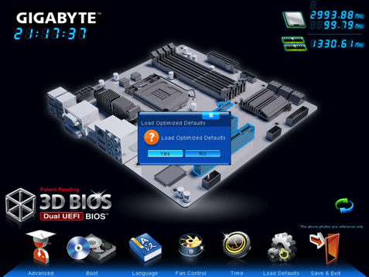
GIGABYTE Confidential: Internal Use Only

Slide 13
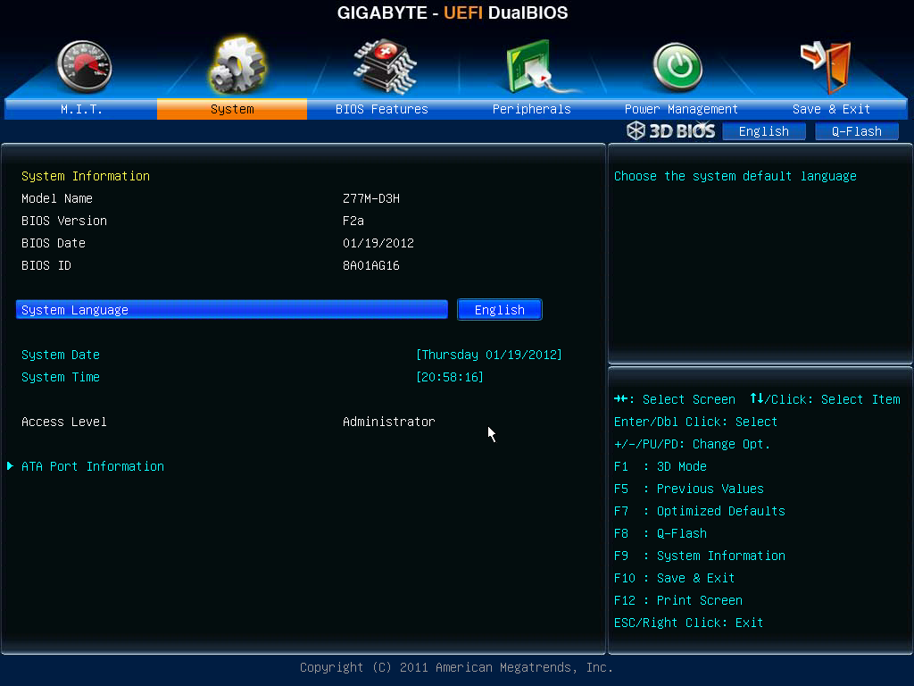
GIGABYTE Confidential: Internal Use Only
UEFI BIOS : Advanced Mode

Slide 14
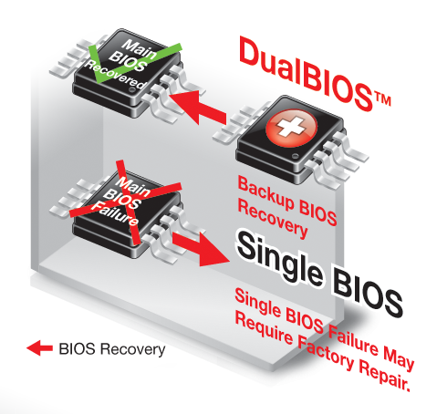


GIGABYTE Confidential: Internal Use Only

Slide 15

GIGABYTE Confidential: Internal Use Only

Slide 16
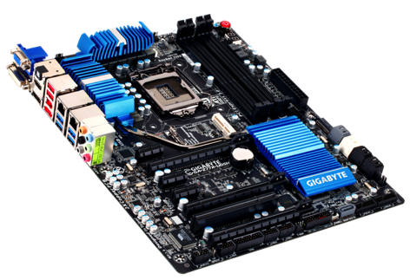

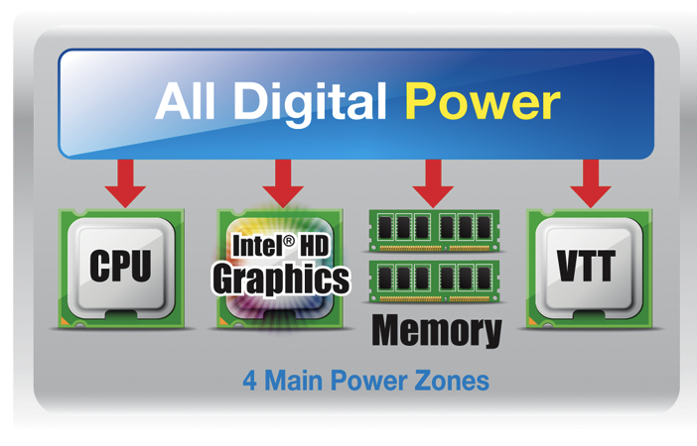
GIGABYTE Confidential: Internal Use Only

Slide 17
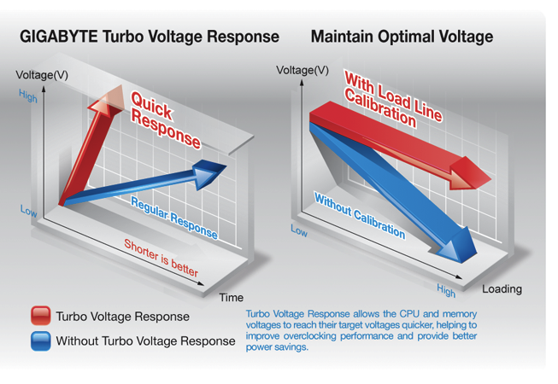
GIGABYTE Confidential: Internal Use Only

Slide 18
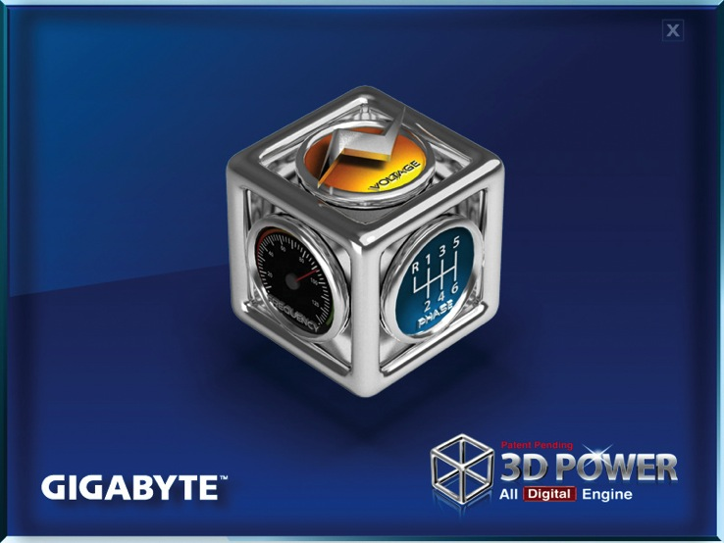
GIGABYTE Confidential: Internal Use Only
3D Power Utility

Slide 19

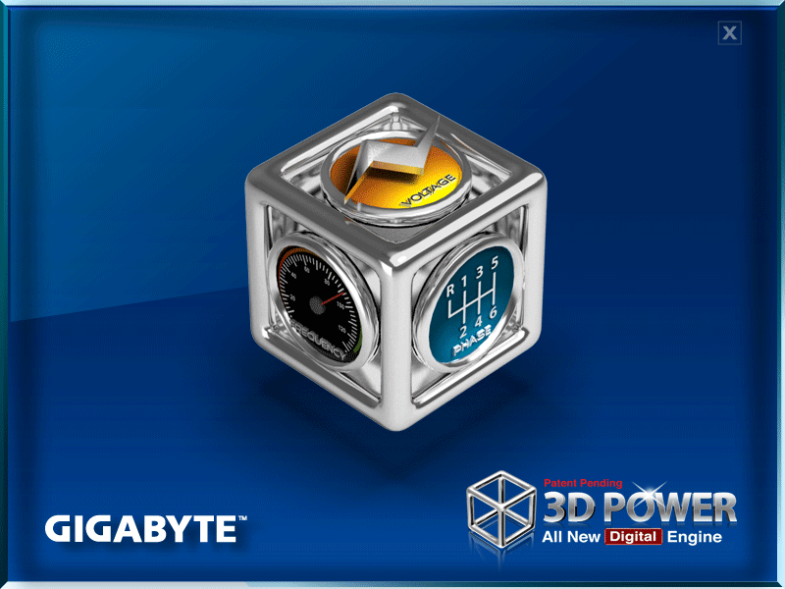
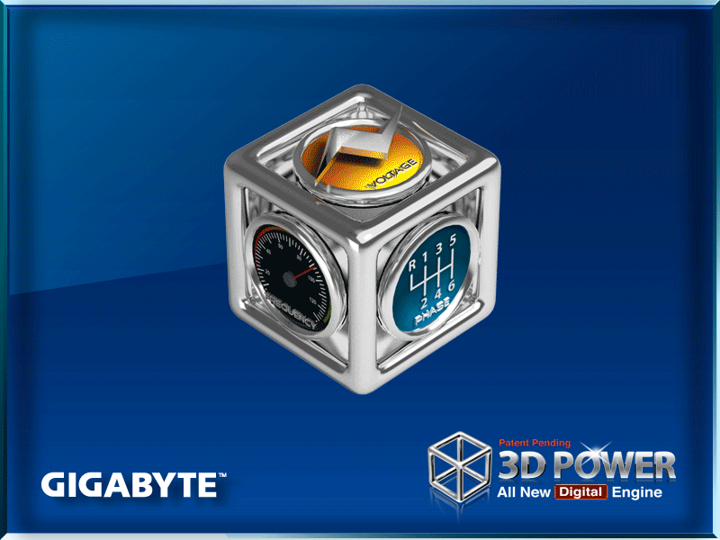
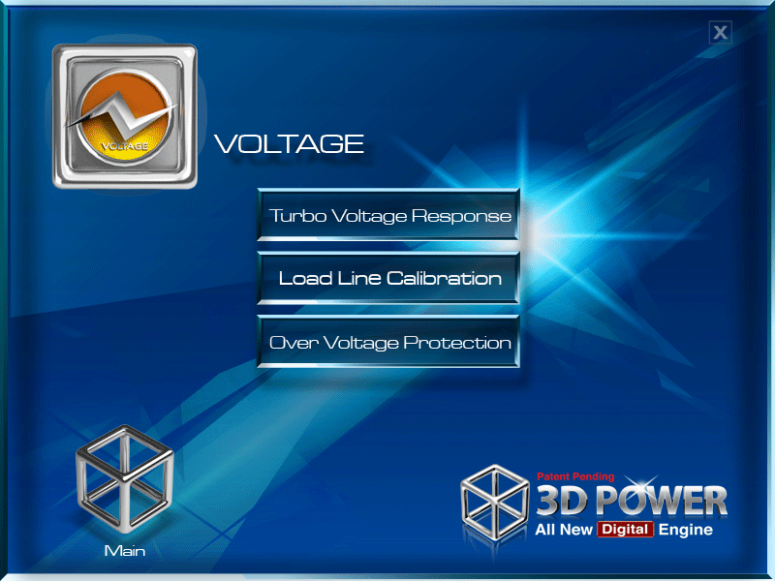
GIGABYTE Confidential: Internal Use Only
3D Power Utility
3D Power utility adjustment setting may vary by model

Slide 20

GIGABYTE Confidential: Internal Use Only

Slide 21
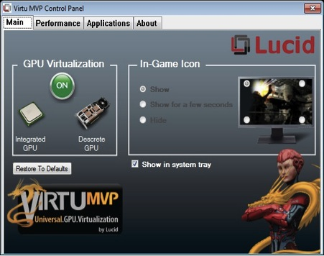

GIGABYTE Confidential: Internal Use Only
Increases gaming frame rates 30-70%
Improves Vsync frame rates – up to 120 FPS
Sharpens visual quality without tearing
Notes:
Virtu Universal MVP is an optimized Lucid Virtu GPU virtualization software that makes your PC look better, respond faster, process video and media smoother, all within a low power environment.

Slide 22

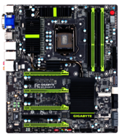


GIGABYTE Confidential: Internal Use Only
Lucid HyperPerformance
Lucid Virtu Combines Intel iGPUs with Discrete Card’s GPUs for added performance boost
GIGABYTE Z77 series motherboard
Intel HD
Graphics
Up to 55% Performance BOOST !
NDA only
3D Mark 11 Extreme

Slide 23
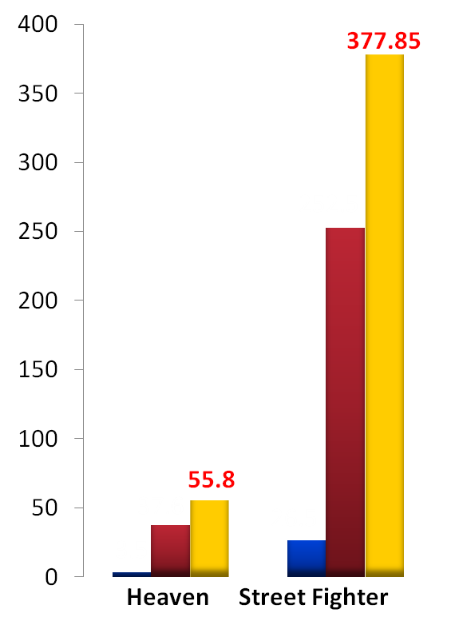
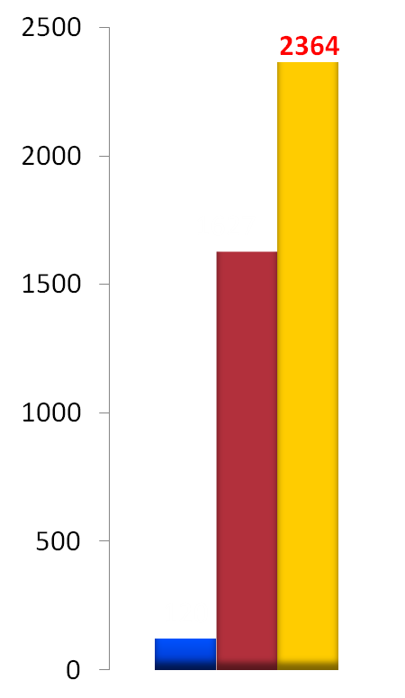
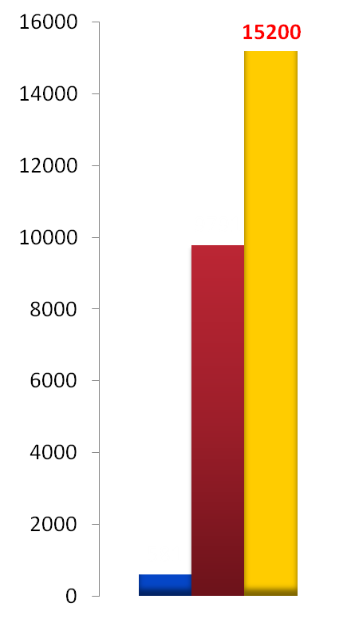
GIGABYTE Confidential: Internal Use Only
World’s 1st IGP Boost: HyperFormance
45.3% Boost
55.2% Boost
49.6% Boost
48.4% Boost
GIGABYTE Z77 + MVP + R6950
GIGABYTE Z77 + MVP + R6950
AMD R6950
GIGABYTE Z77 + MVP + R6950
AMD R6950
AMD R6950
DirectX® 11
DirectX® 10
DirectX® 11
DirectX® 9
Test equip : Intel IVB 3.2G/Z77X-UD3/DDR3 1333/Win7 64Bit

Slide 24

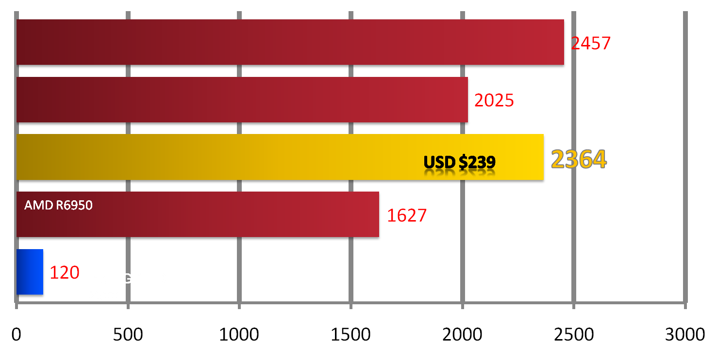
GIGABYTE Confidential: Internal Use Only
Free Upgrade for your Graphics
Performance between 7970~7950
AMD R7970
USD $599
AMD R7950
USD $499
GIGABYTE Z77 + MVP + R6950
USD $239
3D Mark 11 Extreme

Slide 25



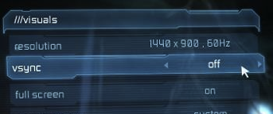
GIGABYTE Confidential: Internal Use Only
Lucid Virtual VSync
Playing 3D Games above 60 FPS often results in image “tearing”
Old solution:
Enable on-game V-Sync setting
Problem: This Limits all frame rate @ 60FPS, also reduce KB+ Mice response time => LAGS

Slide 26
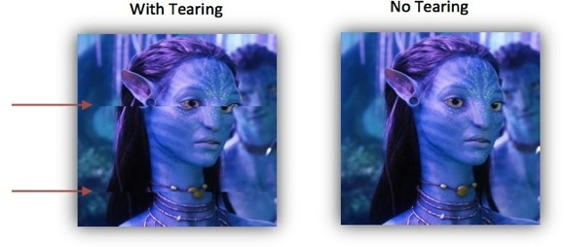
GIGABYTE Confidential: Internal Use Only
Lucid Virtual VSync
New solution: Lucid Virtual VSync
Lucid’s technology maintains high FPS without tearing effect. Also provides high input device response speed.
Lucid Virtual Vsync Delivers:
Enhanced performance - when system has dGPU and iGPU
Unlimited frame rates - beyond traditional in-game VSync
Flawless visual quality without tearing
Up to 250% better responsiveness vs. standard VSync

Slide 27
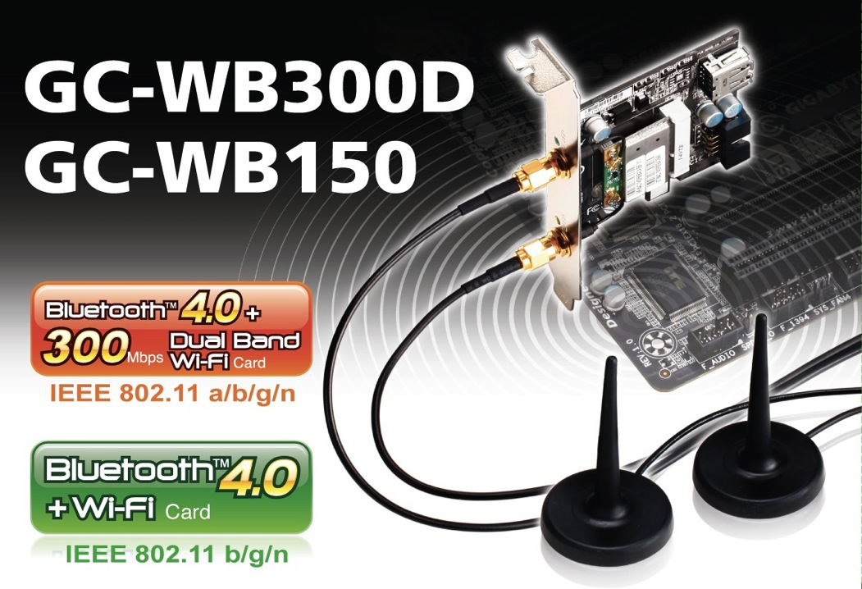
GIGABYTE Confidential: Internal Use Only

Slide 28
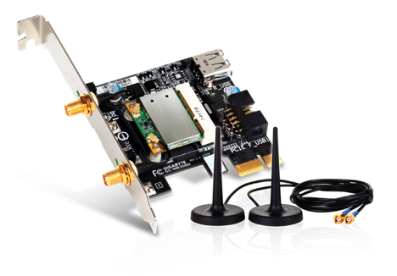
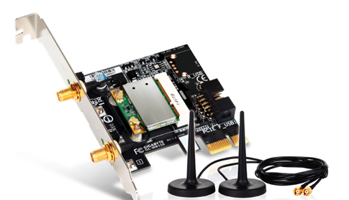


GIGABYTE Confidential: Internal Use Only
GC-WB300D
GC-WB150
Bluetooth 4.0 + 802.11n

Slide 29
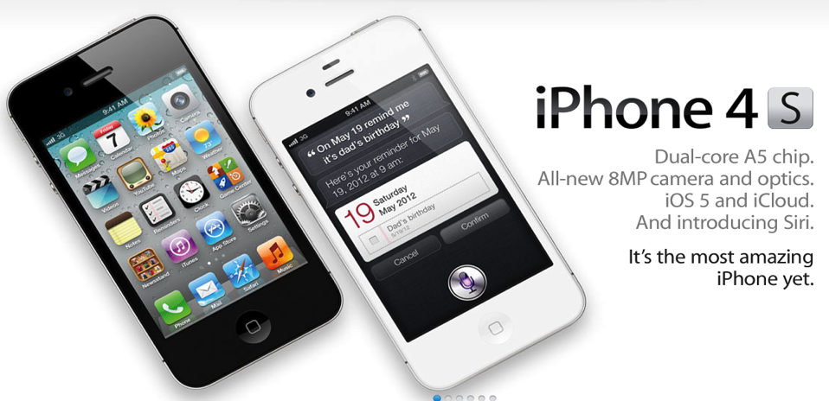

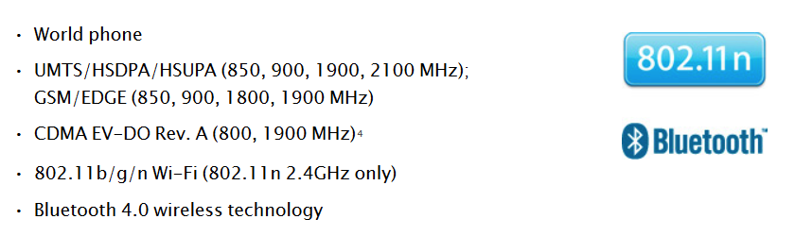
GIGABYTE Confidential: Internal Use Only
Source: Apple website
http://www.apple.com/iphone/specs.html

Slide 30
GIGABYTE Confidential: Internal Use Only
7 series Product Pictures and Retail Boxes

Slide 31
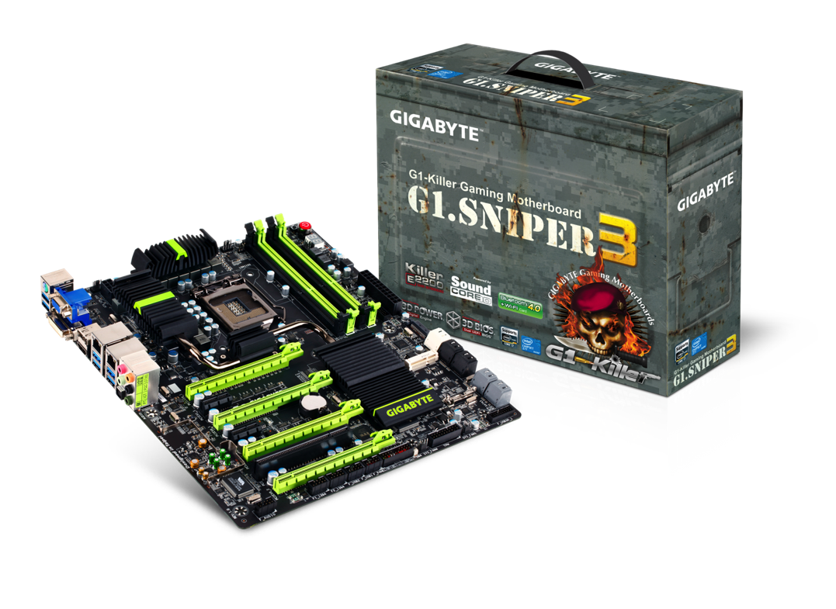
GIGABYTE Confidential: Internal Use Only
G1.Sniper 3

Slide 32
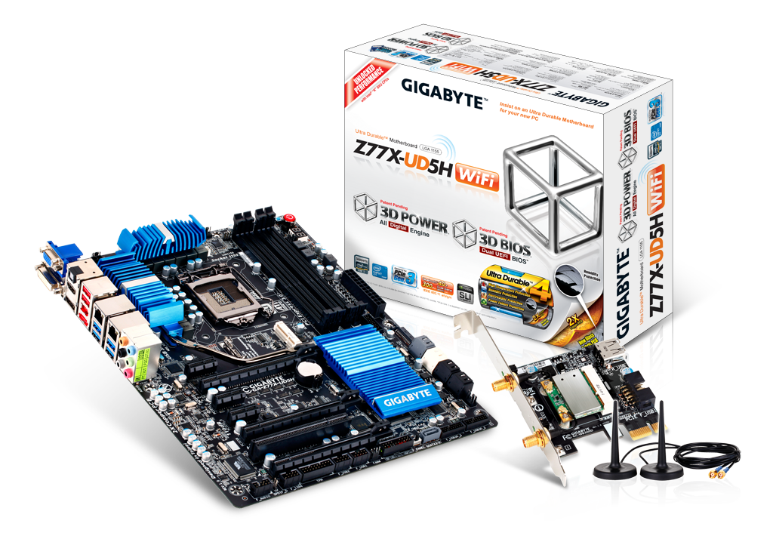
GIGABYTE Confidential: Internal Use Only
Z77X-UD5H WiFi

Slide 33
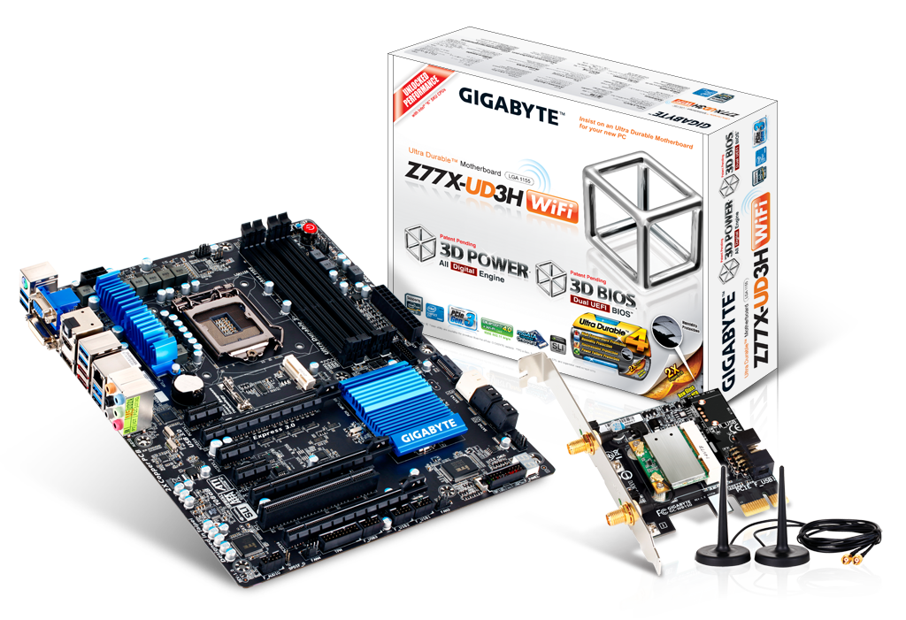
GIGABYTE Confidential: Internal Use Only
Z77X-UD3H

Slide 34
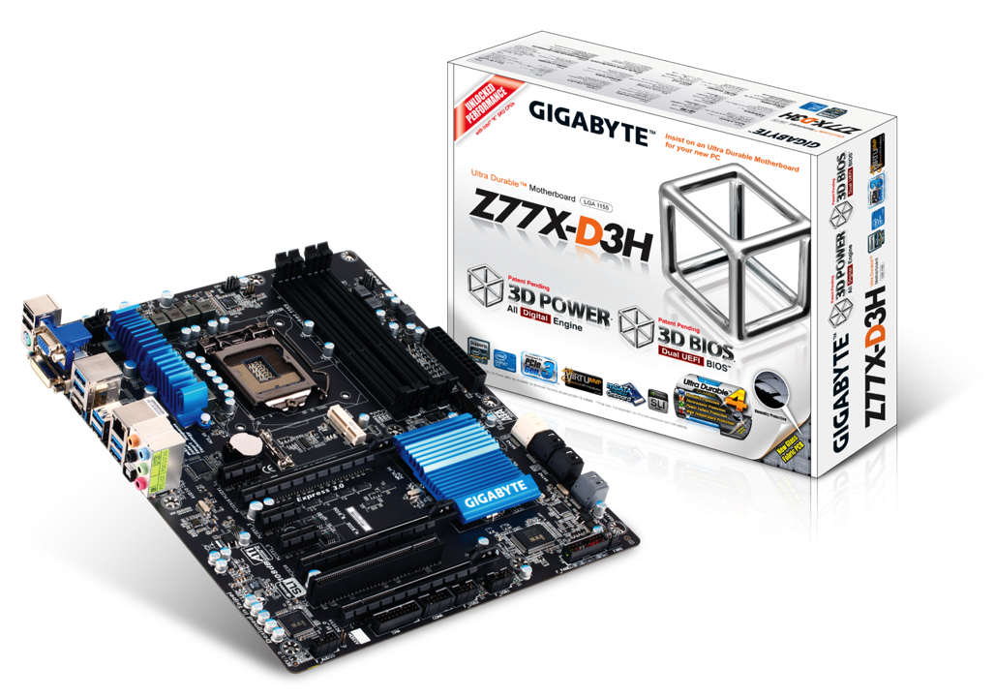
GIGABYTE Confidential: Internal Use Only
Z77X-D3H

Slide 35
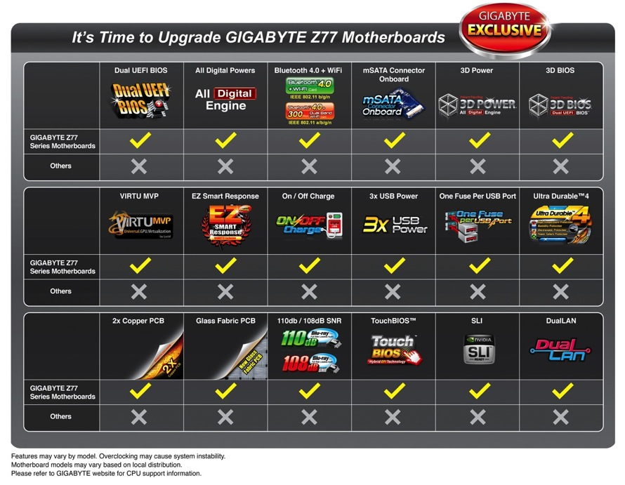
GIGABYTE Confidential: Internal Use Only

Slide 36
GIGABYTE Confidential: Internal Use Only
Thank you

